Slide 1



Dental health
Play this slideshow from beginning
© PSHE Association 2020

Slide 2



  We are learning about good oral hygiene, dental health and how to access NHS services
      We will be able to:
  describe good oral hygiene practices
  explain the impact of diet and substance use on dental health
  describe the differences between dentistry for health and cosmetic purposes
  explain how to access NHS dental services and the importance of having regular check ups
© PSHE Association 2020

Slide 3
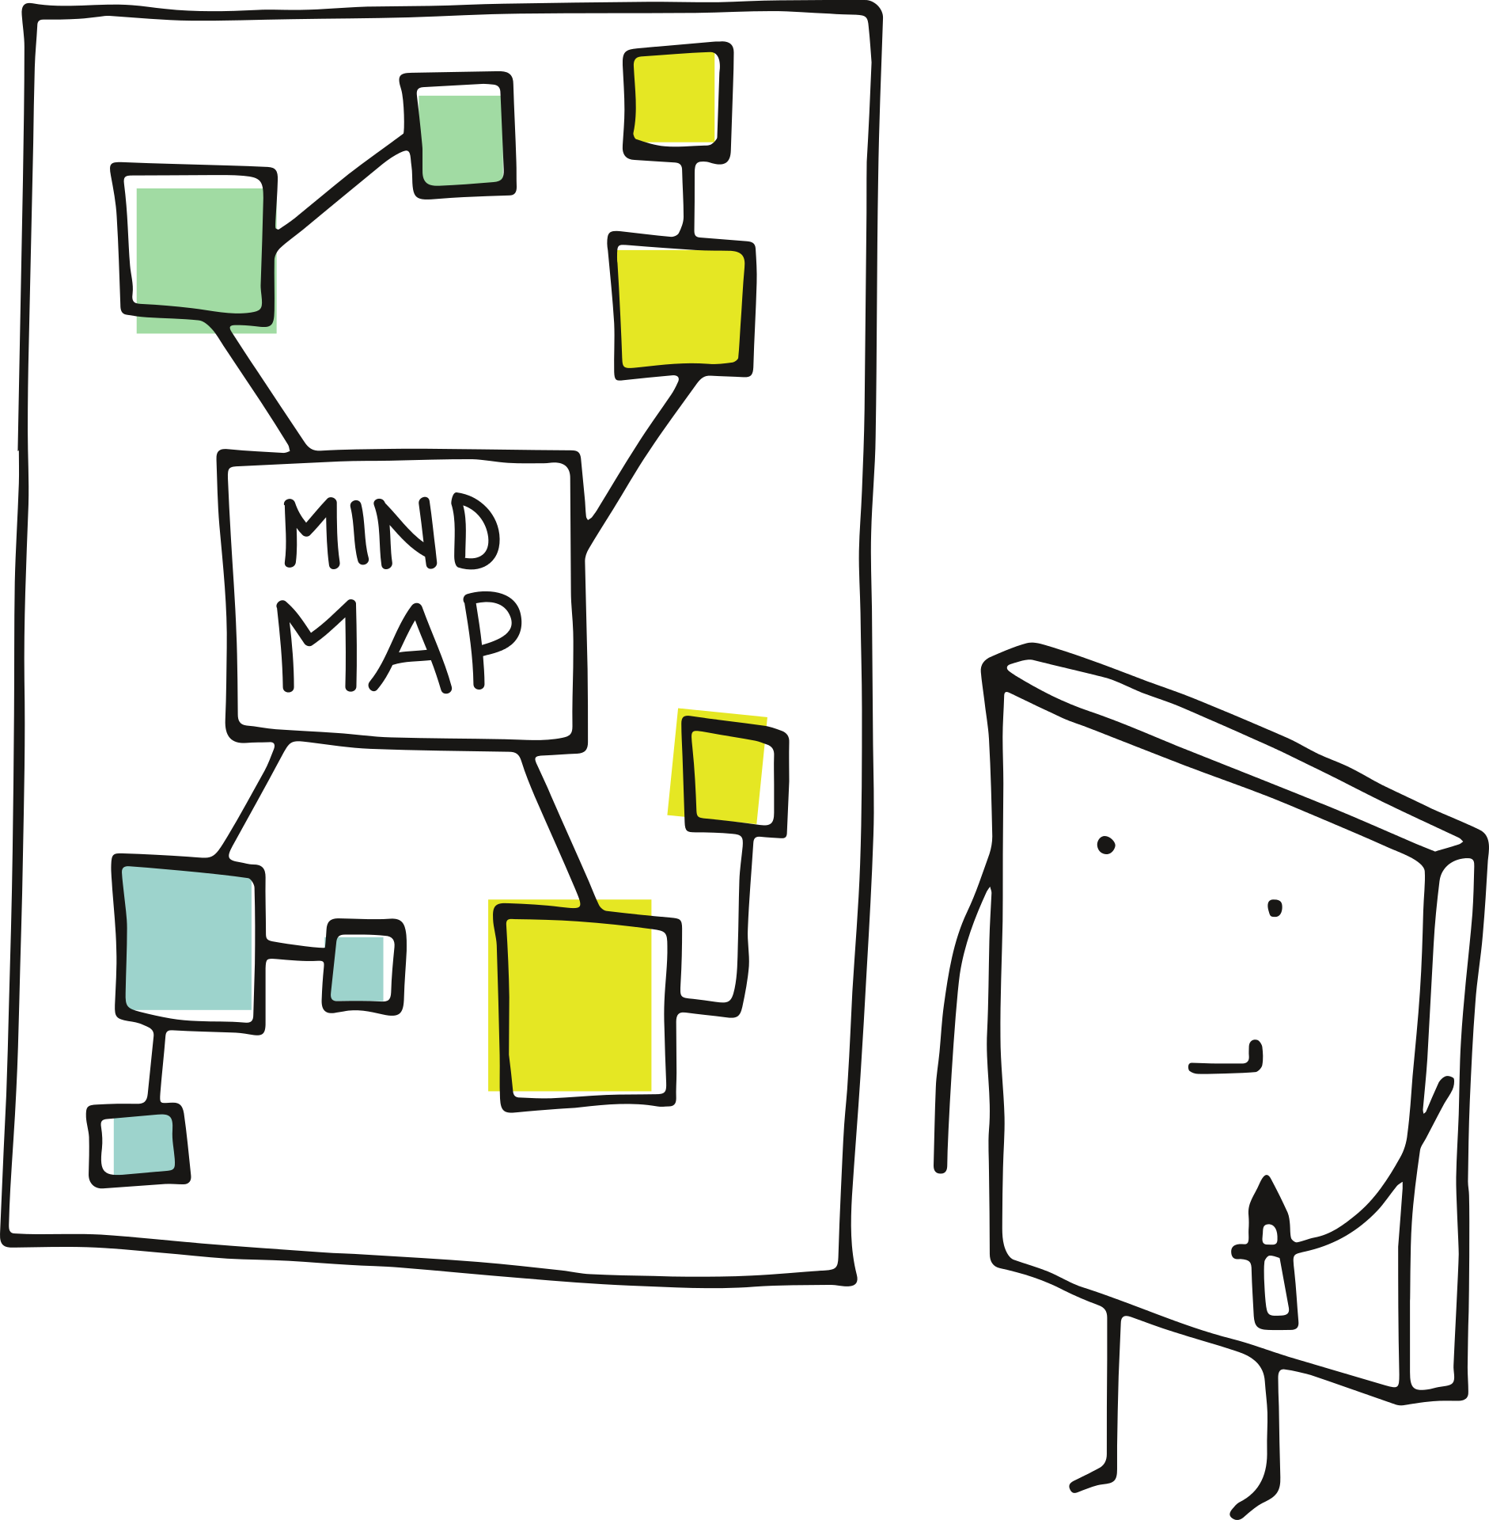
Mind map
Create a mind map around the following question:
“What can someone do to keep their teeth and mouth healthy?”
Once complete, put this to one side — you will come back to it at the end of the lesson!
© PSHE Association 2020

Slide 4
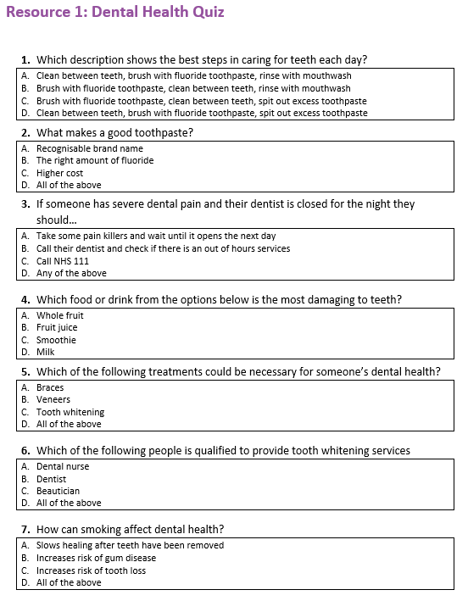
Activity 1: Dental health quiz
Read each question on ‘Activity 1: Dental health quiz’ and circle/write down the answer you think is correct for each question.
Click the boxes on the next slides to reveal the answers…
A B C D
© PSHE Association 2020

Slide 5
Which description shows the best steps in caring for teeth each day? | D | Brush teeth with fluoride toothpaste after interdental cleaning, spit out the excess toothpaste but don’t rinse away as the fluoride continues to work in the mouth.
What makes a good toothpaste? | B | The cost or brand name won’t influence how well a toothpaste works. However, the amount of fluoride is important. Toothpaste should have between 1350-1500ppm fluoride.
If someone has severe dental pain and their dentist is closed for the night they should… | D | If a person has severe dental pain and is unable to access their normal dental service for any reason, they should judge whether painkillers and gentle brushing will help while they wait until the dental practice is open or they can call for out-of-hours services.
Which option below is most damaging to your teeth? | C | Smoothies and fruit juices can provide useful nutrients for the body, however they contain a lot of sugar. Smoothies also have a sticky texture meaning they stay in contact with the tooth surface for longer. Juices/smoothies should be limited to one glass of 150ml per day, with a meal.
© PSHE Association 2020

Slide 6
Which of the following treatments could be necessary for someone’s dental health? | A | Braces can be used to maintain dental health and ensure that teeth aren’t interfering with each other.
Which of the following people is qualified to provide tooth whitening services? | B | Beauticians (someone who gives people cosmetic treatments) and dental nurses (if not aiding a dentist) are not able to provide tooth whitening, and this practice is illegal, as it poses a number of risks to teeth.
How can smoking affect dental health? | D | Smoking affects dental health in a number of ways as it limits the amount of oxygen that reaches soft tissues. It also stains teeth, causes a loss of taste and smell, and can increase the risk of oral cancers.
Using the additional information given in the answers, create a list of 5 top tips for maintaining good dental health.
© PSHE Association 2020

Slide 7
Activity 2: Health or cosmetic?
Sort the cards in ‘Activity 2: Health or cosmetic?’ into the categories “dentistry for health” or “dentistry for cosmetic purposes.”
Dentistry for health aims to keep the mouth and teeth healthy, while cosmetic dentistry is for aesthetics/appearance only.
If they fit in to both categories you may wish to put these in a separate pile.
Alternatively, write ‘H’ (health), ‘C’ (cosmetic) or ‘B’ (both) on each box on the worksheet.
Then, check your answers on the next slides…
© PSHE Association 2020

Slide 8
Health
Having a dental check-up
Getting a filling to treat decay
Removing wisdom teeth (the teeth at the back of your mouth)
Root canal (treating a dead tooth nerve)
Removal of decayed teeth
Cosmetic
Getting veneers (thin pieces of porcelain that cover teeth)
Replacing an existing amalgam (silver) filling with a white filling
Read ‘Activity 2: Did you know…?’ in your worksheet pack to find out more!
Both
Getting braces
Tooth whitening
Scale and polish (when a hygienist removes plaque and tartar from teeth)
Covering a damaged tooth with a crown
© PSHE Association 2020

Slide 9


Activity 3: Scenarios
Read ‘Activity 3: Scenarios’ and, for each character, consider the following questions:
1. What habits might affect the characters’ dental health?
2. Where might they get support or treatment?
3. What considerations would they need to have when deciding whether to get treatment? (i.e. cost or risks)
Then, click on each name on the next slide to check your answers!
© PSHE Association 2020

Slide 10
Activity 3: Scenarios
Bailey
Sky
Bailey is making sensible choices regarding his sugar intake — reducing his risk of tooth decay.
He is looking after his teeth, but he should still visit the dentist for a check up, that way he can keep them healthy.
Having an NHS check-up is free under 19 and would lower the risk of dental issues further down the line.
Sky is taking care of their teeth via positive oral hygiene routines, however a mouth guard should be worn during sports.
If a tooth is knocked out and can be found, the tooth should be held by the crown and not the root. If possible, the tooth should be inserted into the gum socket and Sky should visit the dentist immediately.
Out-of-hours provision can be accessed either by calling NHS 111 or checking the answer phone message of their dental practice.
Sky will get NHS treatment for free. Any wound is at risk of becoming infected, but getting dental treatment would lower this risk.
Jae
Rhea
  Jae’s consumption of sugar will increase his risk of tooth decay. He should also consider cutting back on coffee and quitting smoking.
  He should go to the dentist for regular check ups. He may also want to discuss his stains while he is there, but it’s not essential.
  While check-ups are free and would reduce risk, treatment purely for the appearance of his teeth would have a cost. Treatments like whitening should only be prescribed or performed by a dentist.
Rhea is brushing her teeth but may want to discuss technique with her dentist. She should consider eliminating the soft drinks from her diet.
Rhea should book a check up and continue her normal oral hygiene routines. If her gums are tender or sore she may wish to brush more gently.
If Rhea needs any treatment this will be free, as will any advice on oral hygiene from the dentist. Going to the dentist would reduce the risk of the bleeding getting worse.
© PSHE Association 2020

Slide 11

What have you learnt?
Looking at the mind map you completed at the start of the lesson, in a different colour, add new information on what you have learned about dental health.
  Consider the following:
    How can dental health be maintained?
    Who can you contact to support good dental health?
    What are the differences between cosmetic dentistry and dentistry for health?
© PSHE Association 2020
Notes:
.

Slide 12

Further support
The NHS Choices website has advice on dental health.
www.nhs.uk
If you’re worried about your dental health, you can always speak to your parent or carer, or a teacher in school for more advice and support.
The Change4Life website has advice for making healthy choices.
www.nhs.uk/change4life
NHS Direct (Tel: 111) can be called for non-urgent medical issues or for further information.
© PSHE Association 2020

Slide 13
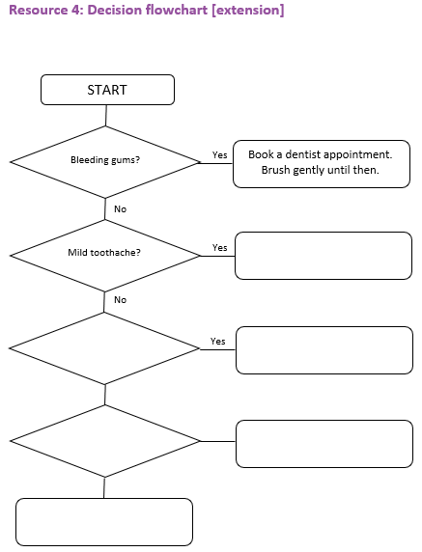
More activities
Dental health decision flowchart
Complete the flowchart template to show how to choose which dental health support service to access.
© PSHE Association 2020

