Slide 1



Z
Z
Z
Z
Healthy sleep
Play this slideshow from beginning
© PSHE Association 2020

Slide 2



  We are learning about healthy sleeping habits
      We will be able to:
  explain the impact of sleep on health and wellbeing
  describe healthy sleep patterns and identify factors which can reduce sleep quality
  describe a range of strategies for ensuring appropriate sleep patterns
© PSHE Association 2020

Slide 3
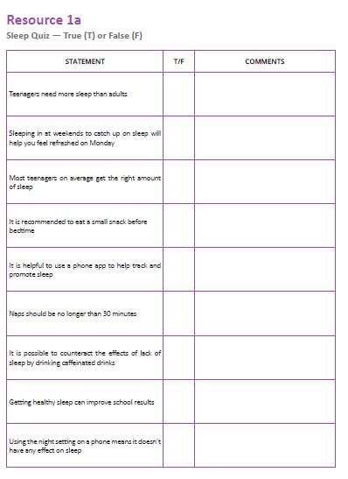
Activity 1: Sleep quiz
Look at each statement in the table (‘Activity 1: Sleep quiz’) and decide if it is true or false.
If you think it’s false, write what you think the truth might be in the comment box next to the statement.
Check your answers by clicking on each box on the next slide!
Z
Z
Z
© PSHE Association 2020

Slide 4
STATEMENT | T/F | COMMENTS
Teenagers need more sleep than adults | T | Research shows the average teenager needs just over 9 hours sleep a night, whereas the average for adults is 7 hours. This can be particularly challenging to manage as teenagers often don’t feel tired until considerably later (e.g. 11pm) and have changing routines that require them to wake up in time for school.
Sleeping in at weekends to catch up on sleep will help you feel refreshed on Monday | F | This can actually make sleep worse. An erratic sleep schedule (for eample staying up later at weekends and sleeping in later) make it even harder to fall asleep on Sunday night and wake up on Monday morning. It is much better to maintain regular wake hours over the weekends to keep the body in routine.
Most teenagers on average get the right amount of sleep | F | Due to problems highlighted above, the majority of teenagers are sleep deprived, (often by more than 2 hours of required sleep per night) which accumulates over time.
It is recommended to eat a small snack before bedtime | T | It is a good idea not to go to sleep hungry. While a big meal right before sleep is not advisable, a small snack before bed can help with falling asleep and improve sleep quality.
It is helpful to use a phone app to help track and promote sleep | F | Lots of apps suggest they can help to promote or track sleep, however little research has been done into how effective these really are. Any benefits the app may provide are also likely to be outweighed by having the phone on the bedside table, as the lights on phones and constant notifications throughout the night can have a significant negative impact on sleep
Naps should be no longer than 45 minutes | T | Napping can help sleepiness, but should be no longer than 15-30 mins and in the early afternoon. Napping for longer than this or late in the afternoon can make it difficult to fall asleep at night. Naps should only be used as a technique if absolutely necessary; it is much better to try to improve the quality and length of night-time sleep
It is possible to counteract the effects of lack of sleep by drinking caffeinated drinks | F | Caffeine can give the body a temporary energy boost but it can have sig- nificant detrimental effects over time. Caffeine products are potentially addictive and can impact health; they also disrupt sleep even further.
Getting healthy sleep can improve school results | T | Research suggests that students who get the best results in tests sleep more than their peers. Sleep can improve brain functions such as memory, organisation, decision making and attention.
Using the night setting on a phone means it doesn’t have any effect on sleep | F | As blue light filter apps are relatively new, research studies have not yet been published. However, using your phone before sleep still has other impacts as people are engaging in conversations, games, processing information etc. at a time when the brain needs them to wind down

Slide 5
Activity 2: Sleep benefits
Most important
1st
What are the benefits of sleep?
Complete the diamond 9 on the worksheet (‘Activity 2: Diamond 9’) by putting the benefit you think is most important at the top, then the next two most important benefits, down to the one you think is least important at the bottom.
2nd
2nd
3rd
3rd
3rd
Could you prioritise the cards in two different orders, thinking about a young person’s priorities:
during exam time
during the summer holidays? Have any priorities changed?
4th
4th
5th
Least important
© PSHE Association 2020

Slide 6
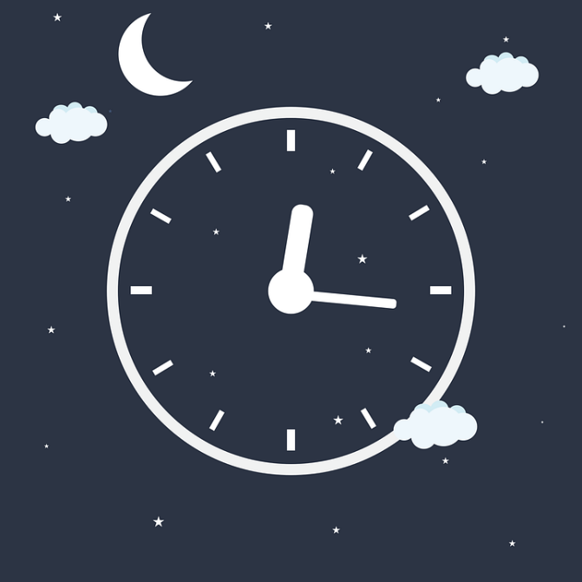
Activity 3: Sleep strategies
What techniques or strategies could someone use to get better sleep?
Using the answers from the quiz to help you, make a list of Do’s and Don’ts that someone could use to promote good quality sleep.
Think about the following questions:
What should the bedroom environment be like for good sleep?
What activities should be avoided before sleep?
What routines might make someone feel calm, relaxed and ready for sleep?
What could someone do if they were struggling to fall asleep?
© PSHE Association 2020

Slide 7
Activity 4: Sleep scenarios
Read through the sleep scenarios on the worksheet (‘Activity 4: Sleep scenarios’) and consider the following key questions…
Klaudia
Benji
Klaudia needs to review her schedule as she is currently only getting 7 hours’ sleep.
She is eating and exercising very late.
She should think about how to prioritise or reorganise her schedule so that she is able to get better sleep.
Benji has very erratic sleep patterns.
He should reduce his use of caffeine drinks (especially in the afternoon).
He should try to avoid napping and sleeping in at the weekends.
Instead he needs to establish a more consistent routine.
1. What habits might be preventing each character from getting good quality sleep?
2. What might be the consequences for each character if they don’t get good quality sleep?
3. What could each character do differently to help them get better quality sleep?
Then, click on each name to check your answers!
Ryan
Shaznay
Ryan needs to focus on reducing his stress.
He could organise his school bag in the evening before bed.
He should try to do something relaxing and calming before bed.
This will mean he is better able to function (and feel less stressed) the next day.
Shaznay may be more affected by her phone than she thinks.
Regular disturbances during the night and looking at backlights before sleep lead to poorer quality sleep overall.
She should remove her phone from her bedroom at night and make sure it is turned off.
© PSHE Association 2020

Slide 8

What have you learnt?
Complete the following three sentences:
Three things that help promote good sleep are…
Two benefits of good quality sleep are…
One thing I could change about my evening routine to promote better sleep is…
© PSHE Association 2020

Slide 9

Further support
If you’re worried about your sleep, you can always speak to your parent or carer, or a teacher in school for more advice and support.
The ChildLine website has advice about sleep for young people:
www.childline.org.uk
Phone: 0800 1111
NHS Direct (Tel: 111) can be called for non-urgent medical issues or for further information.
© PSHE Association 2020

Slide 10

More activities
Healthy sleep into action
Now that you have reflected on one thing you think you could change about your evening routine to promote better sleep, try to stick to this for one week!
Write a short reflection about any changes you have noticed to your sleep (or other benefits) at the end of the week.
Healthy sleep campaign
Create an advertising campaign to promote healthy sleep.
This could include …
A poster or flyer to raise awareness
A tagline or slogan
A logo
An information
leaflet
© PSHE Association 2020

